Slide 1
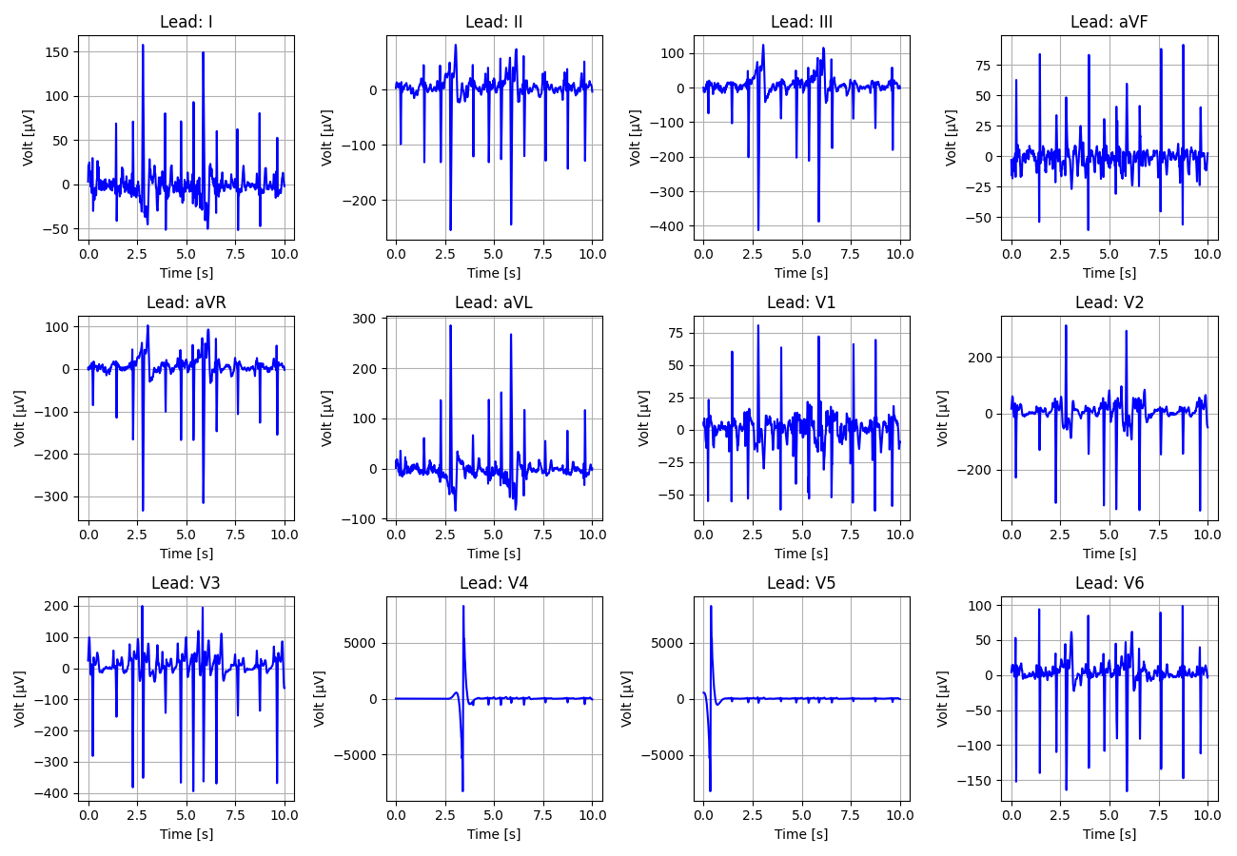
101_Recording_1548723

Slide 2
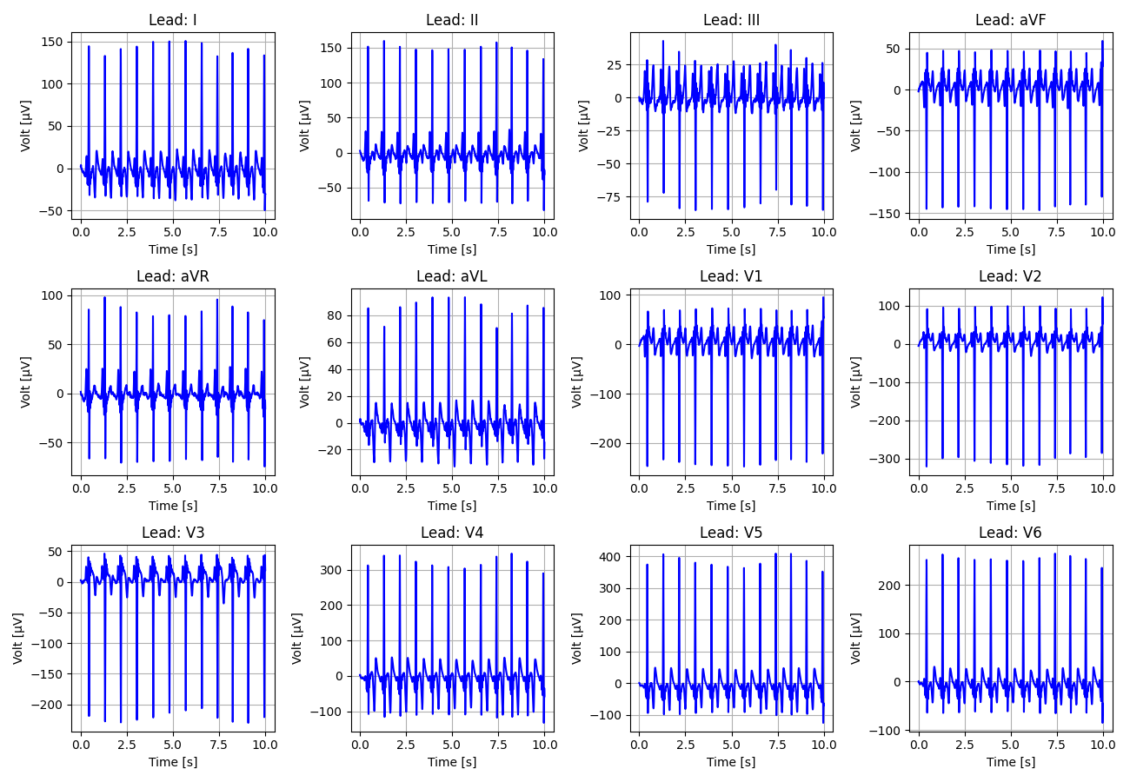
102_Recording_1904144

Slide 3
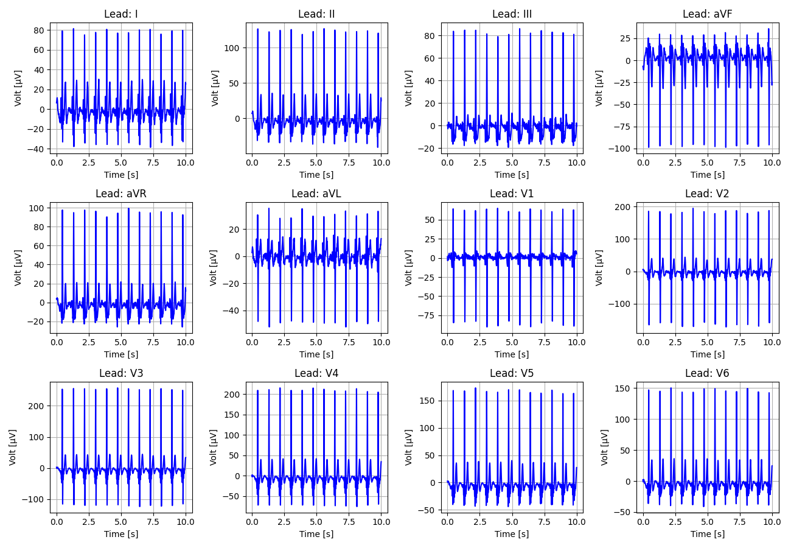
103_Recording_2087383

Slide 4
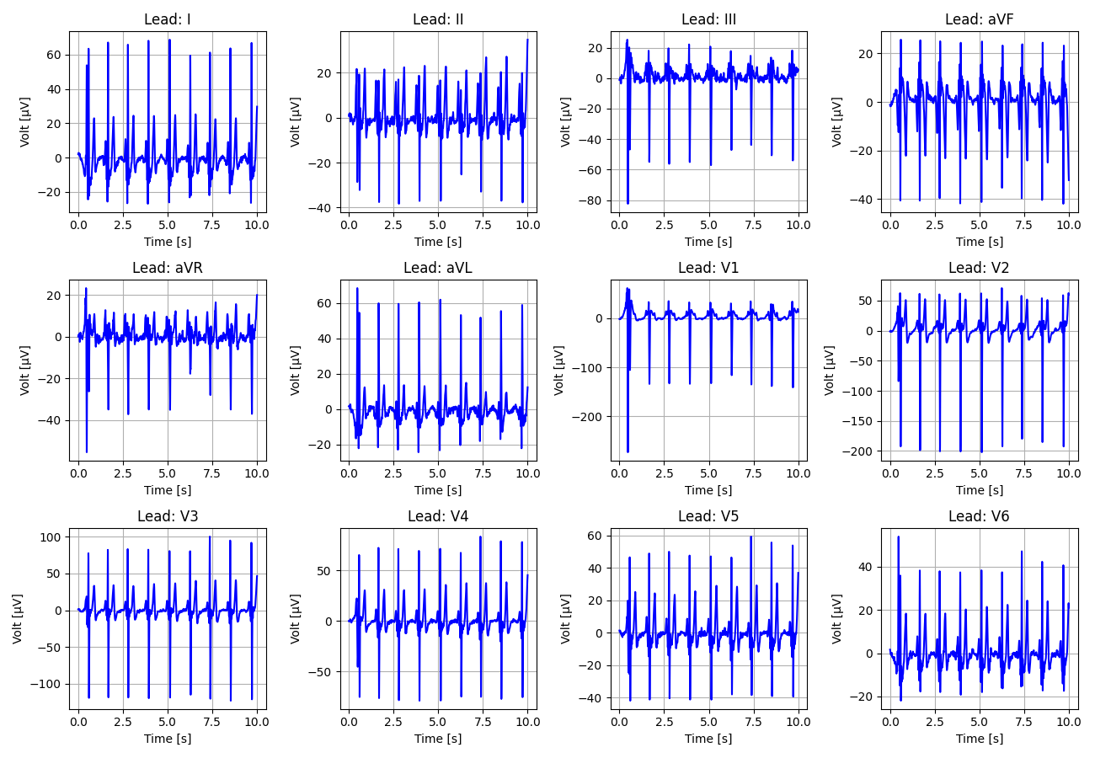
104_Recording_2196143

Slide 5
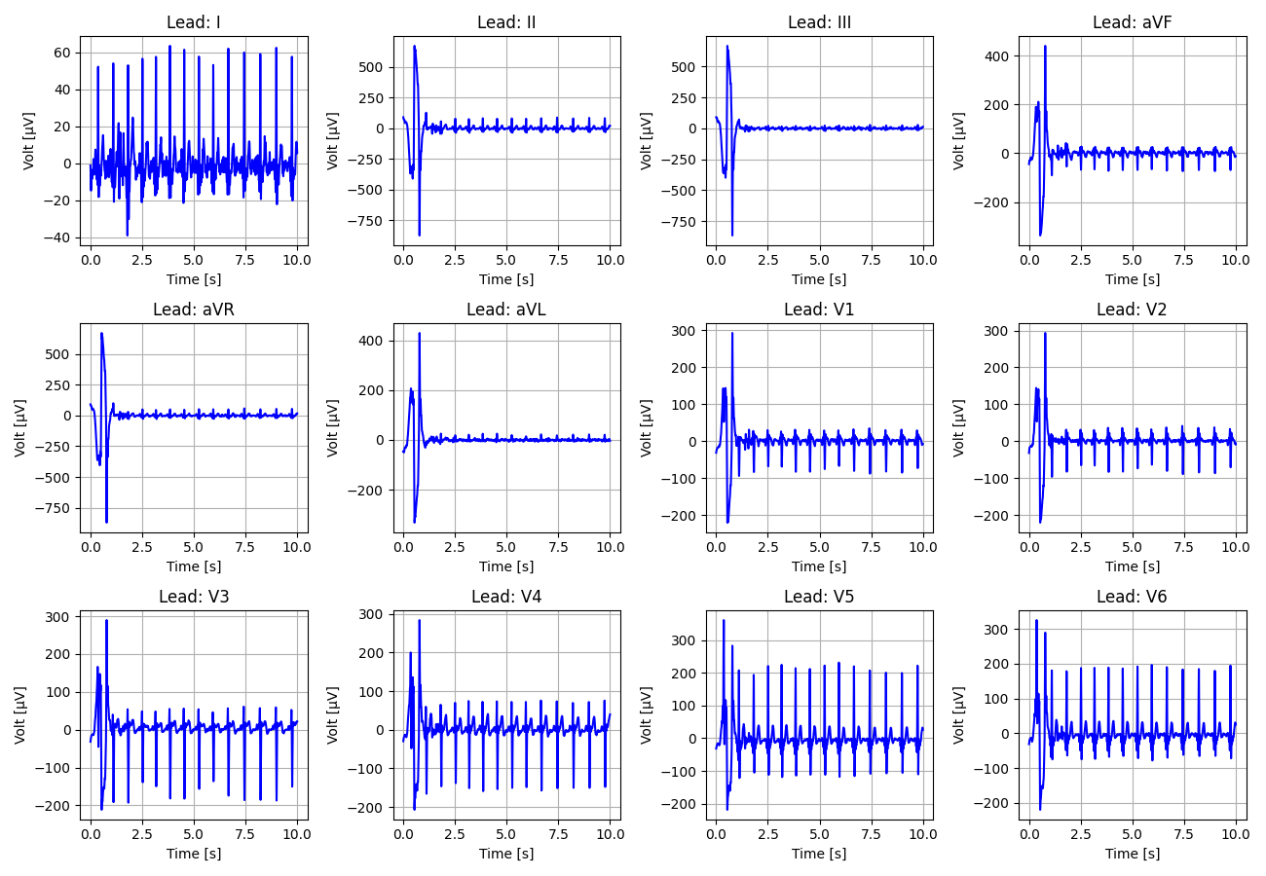
105_Recording_2449723

Slide 6
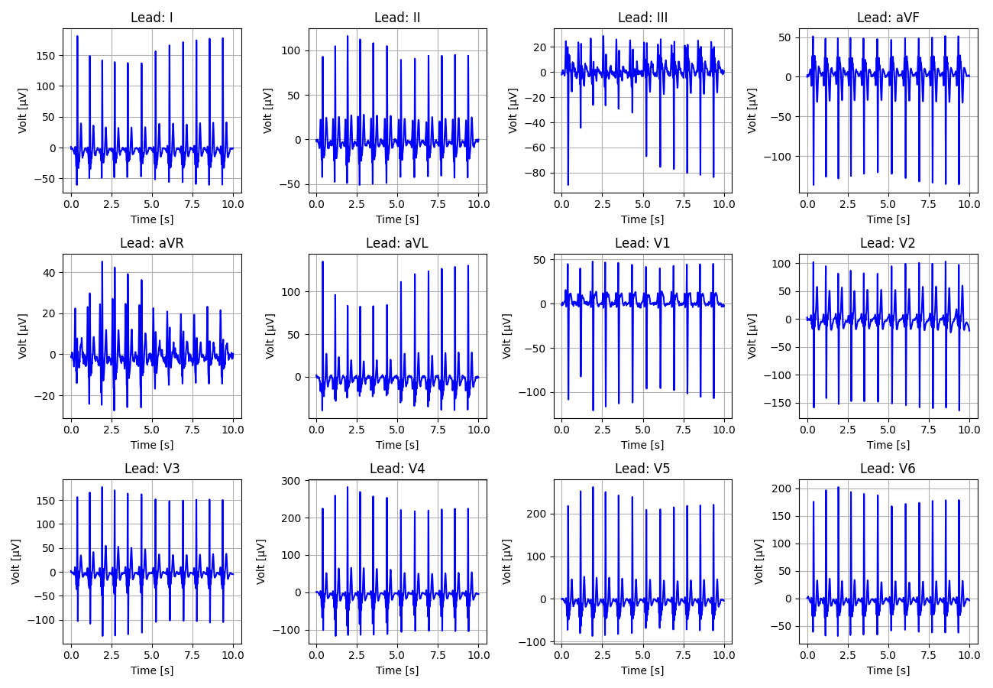
106_Recording_2994306

Slide 7
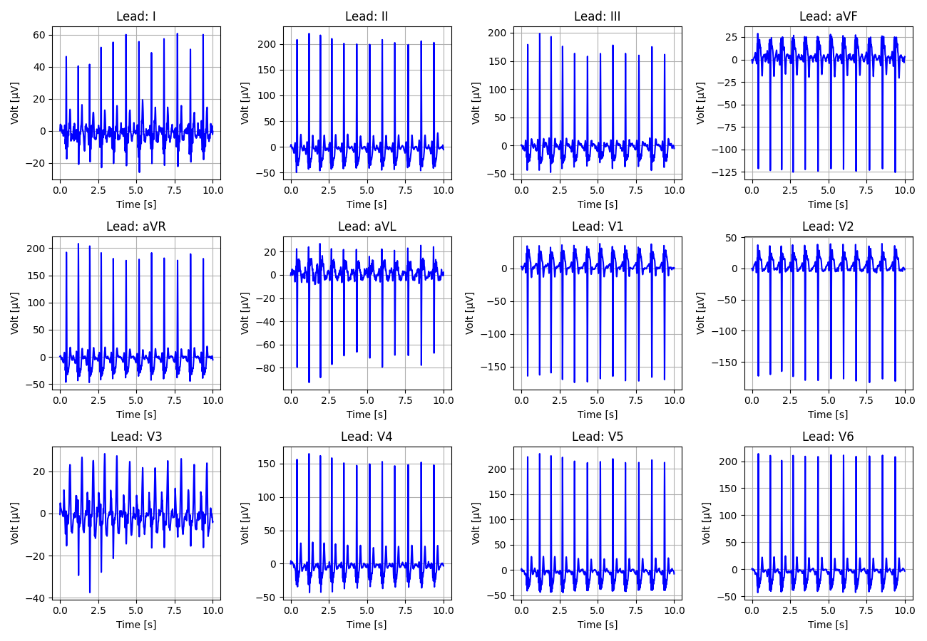
107_Recording_2801034

Slide 8
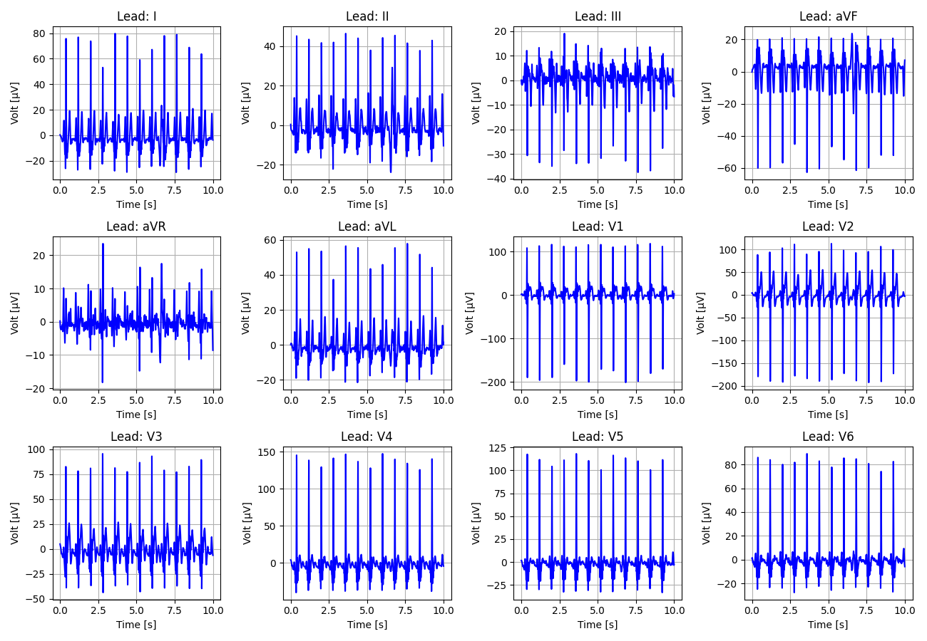
108_Recording_1058551

Slide 9
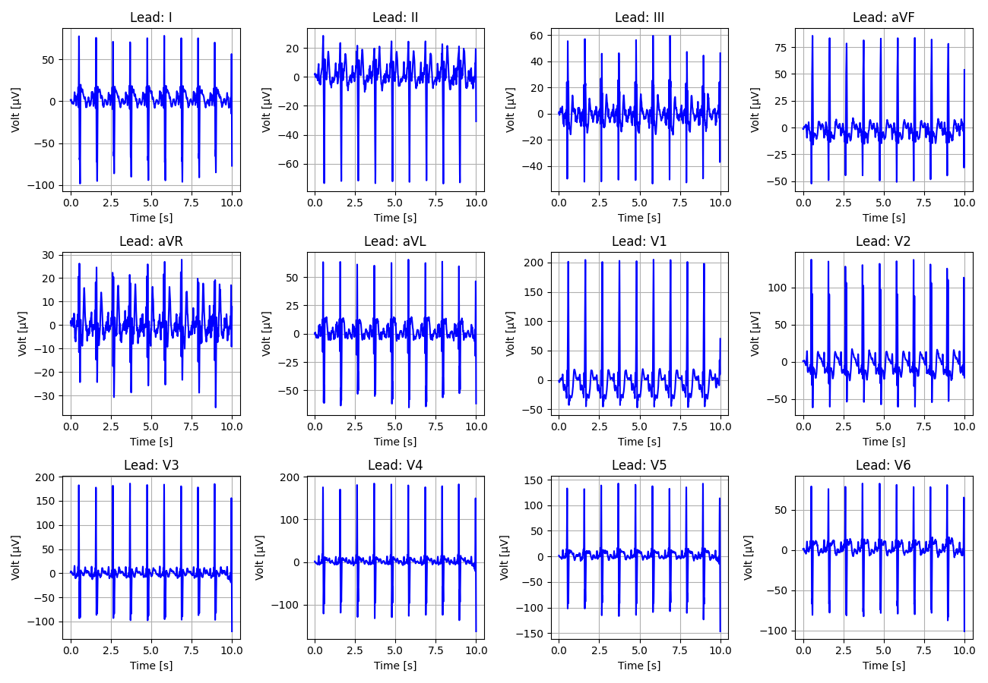
109_Recording_2933532

Slide 10
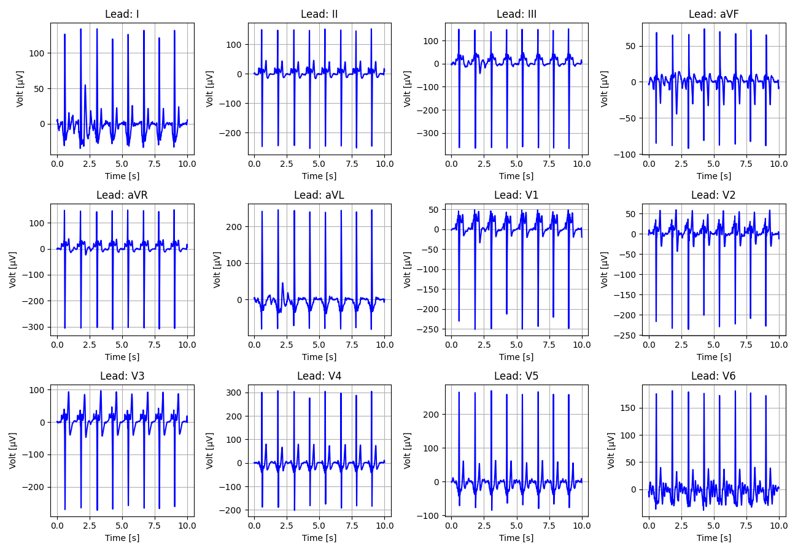
110_Recording_1475480

Slide 11
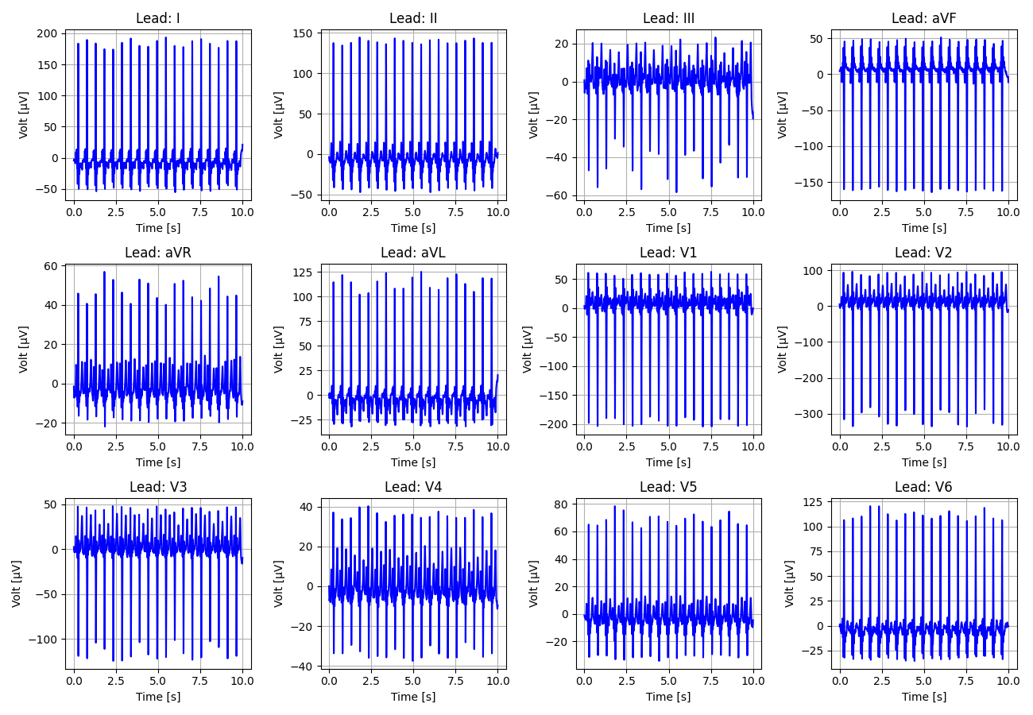
111_Recording_1315318

Slide 12
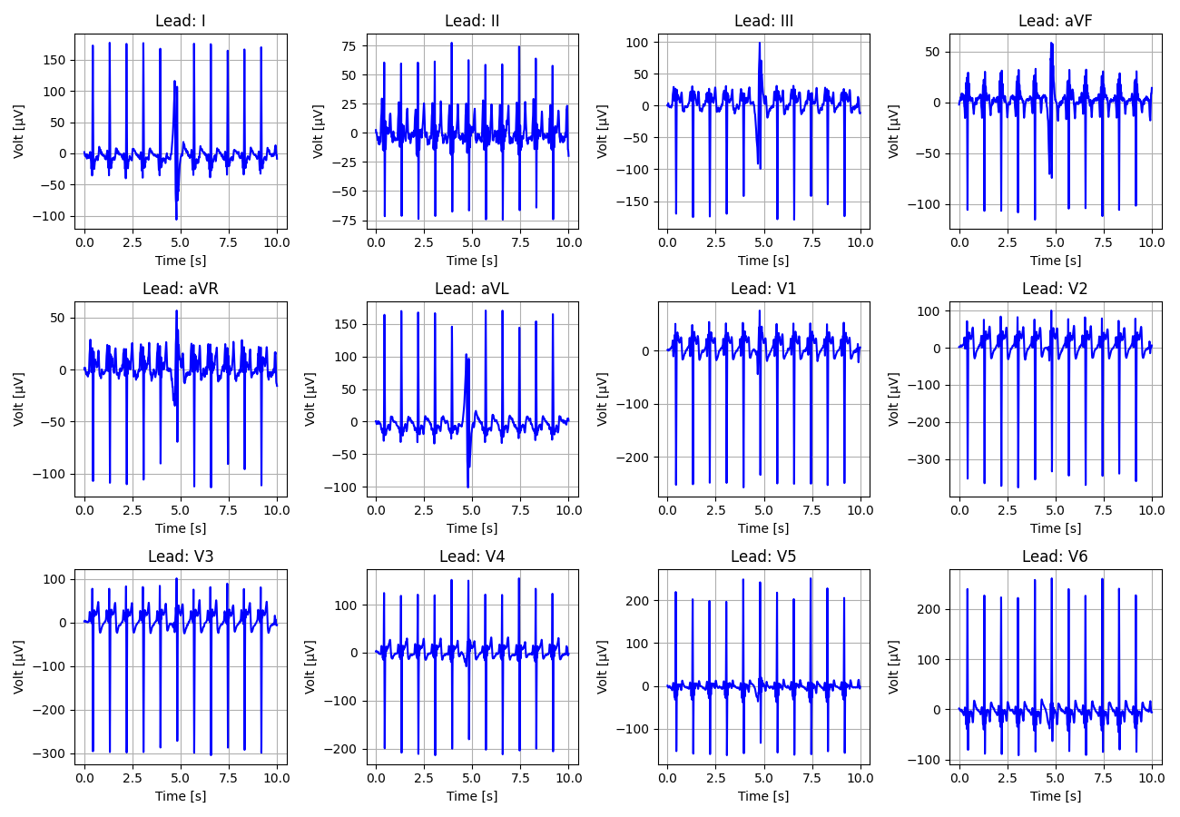
112_Recording_1563789

Slide 13
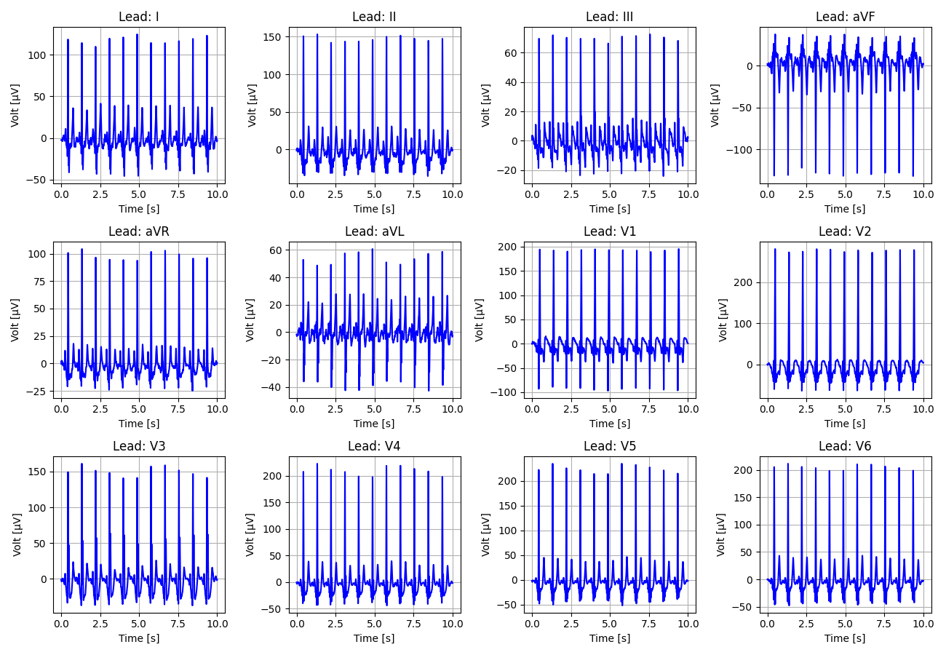
113_Recording_1865054

Slide 14
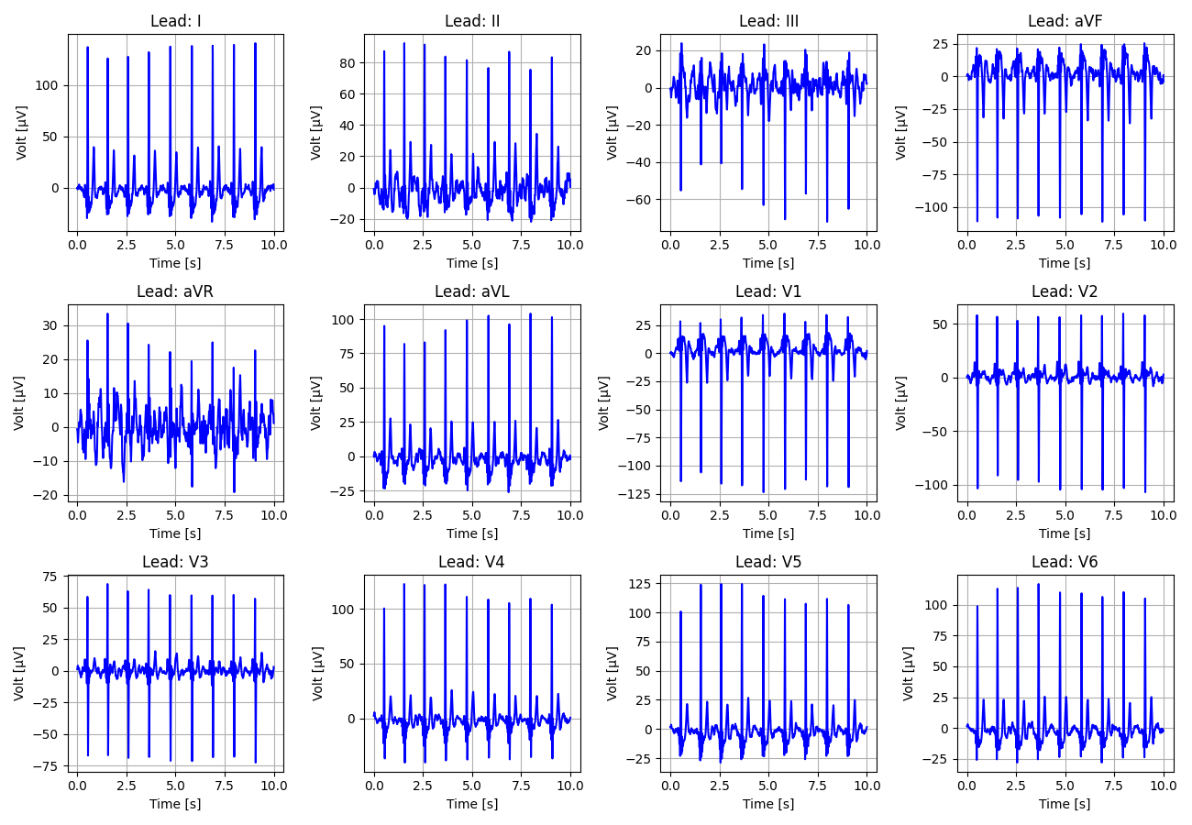
114_Recording_1827761

Slide 15
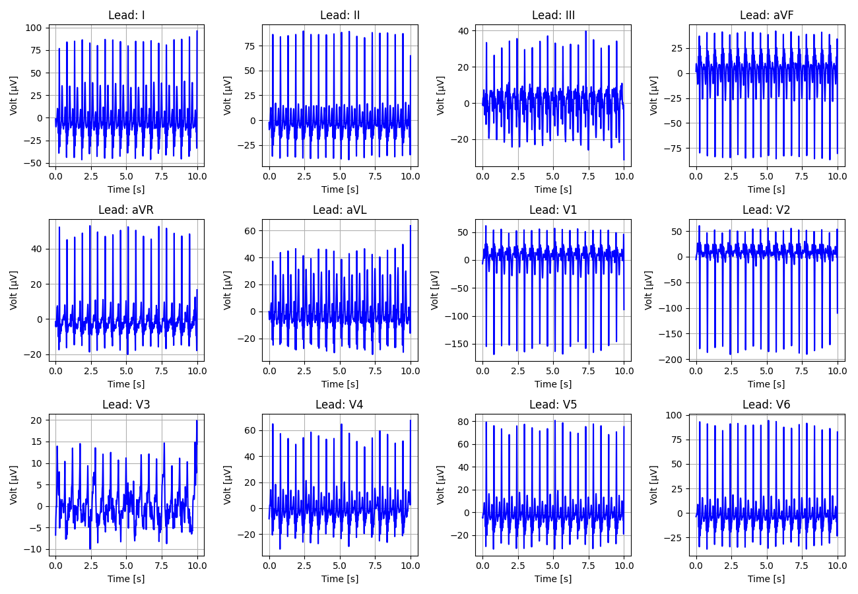
115_Recording_2887999

Slide 16
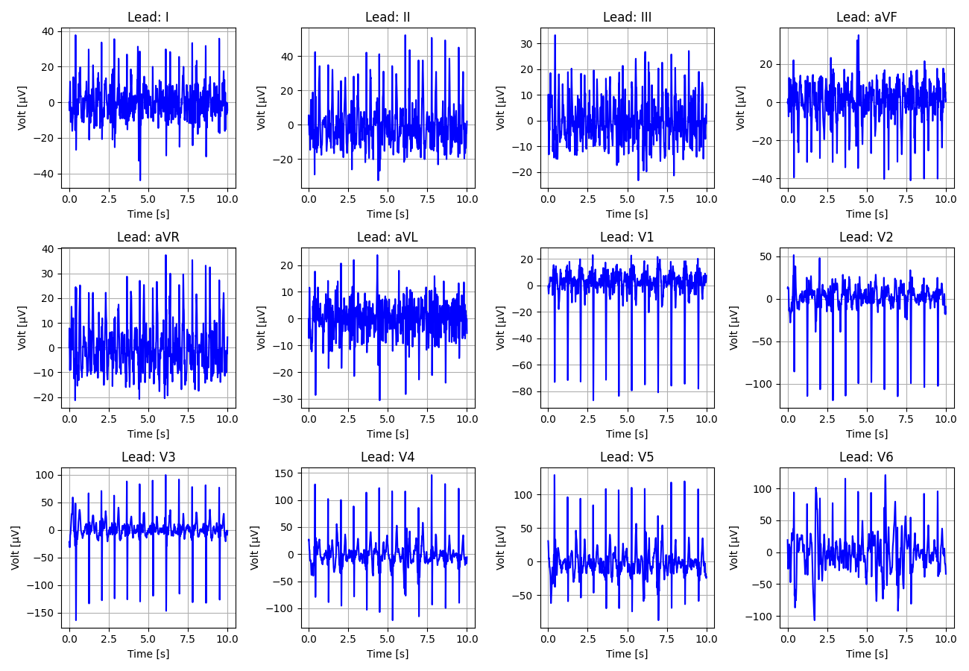
116_Recording_2511429

Slide 17
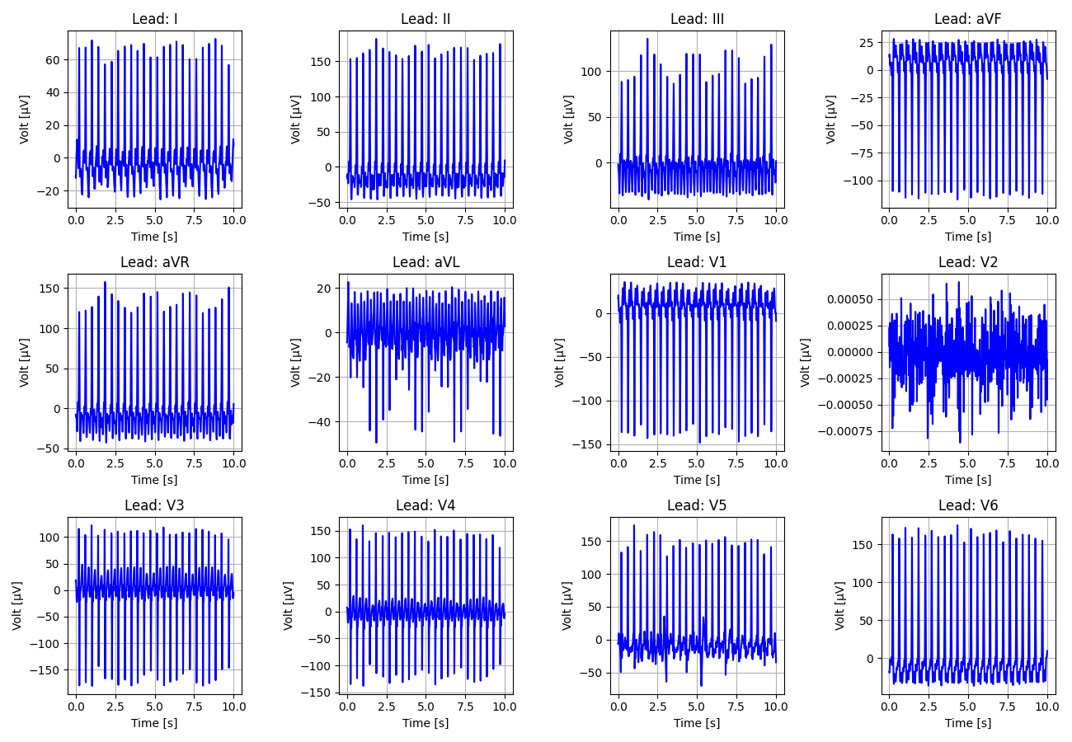
117_Recording_2536401

Slide 18
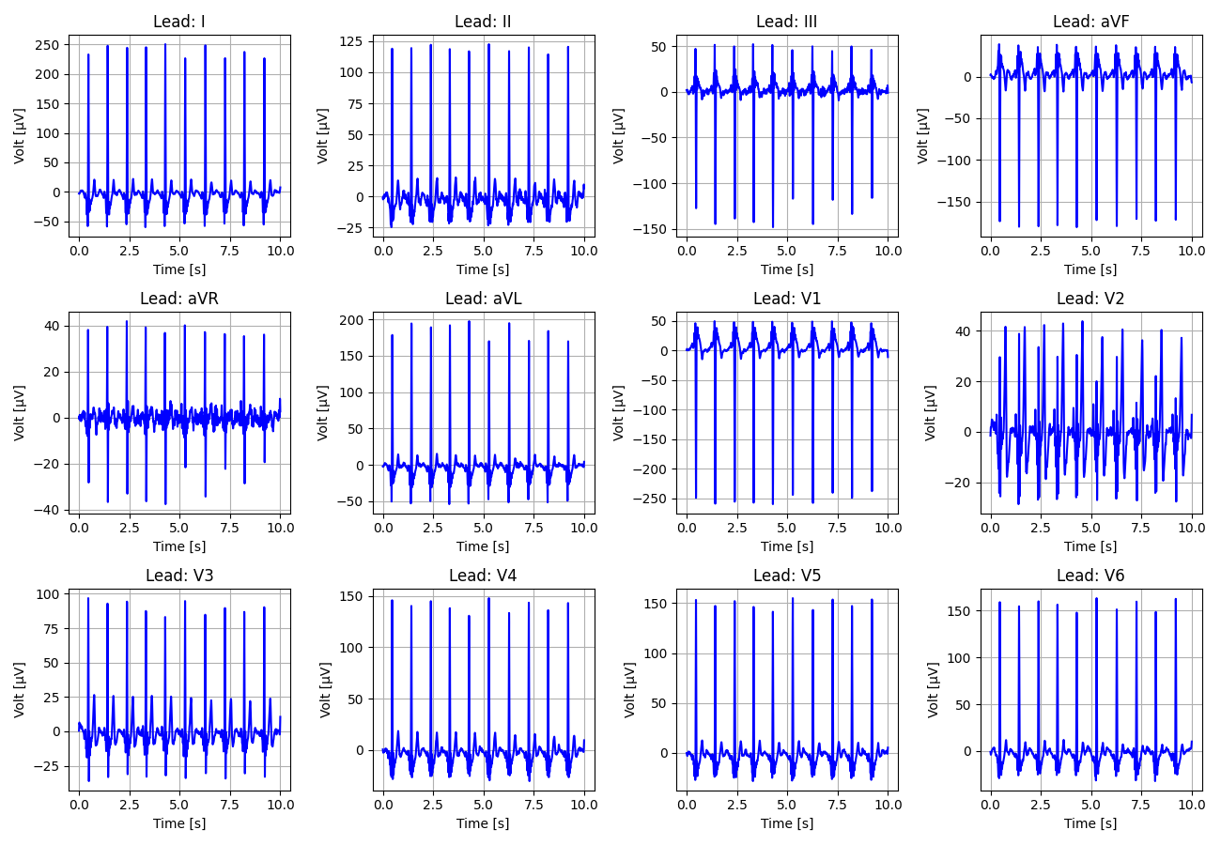
118_Recording_1465628

Slide 19
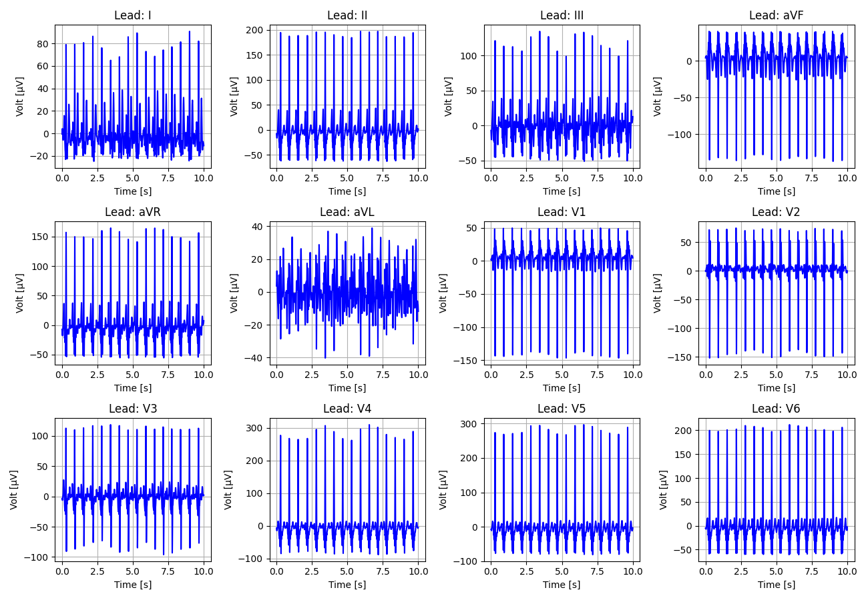
119_Recording_2678169

Slide 20
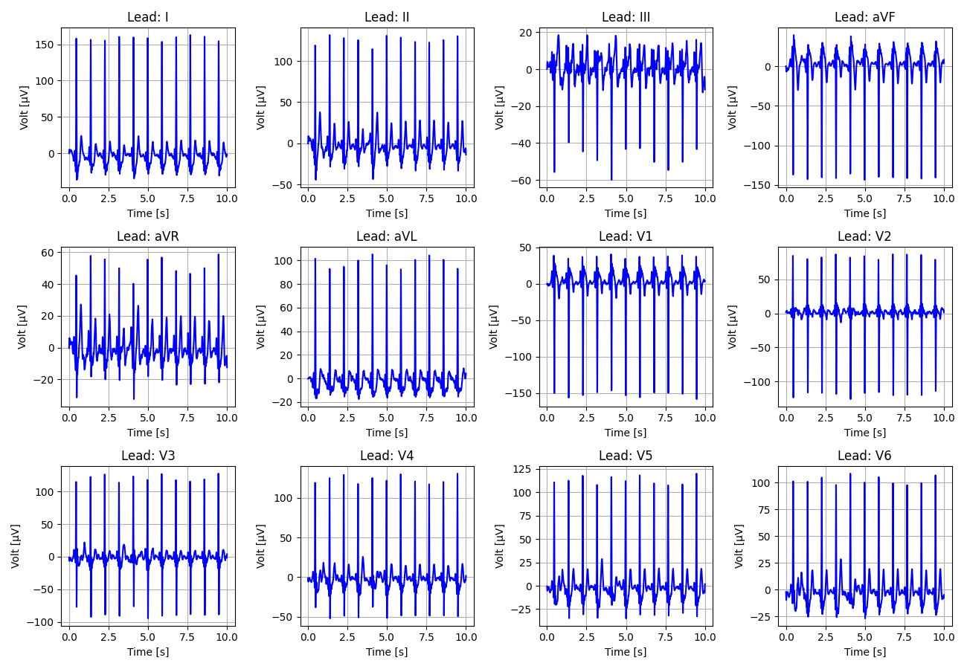
120_Recording_2360557

Slide 21
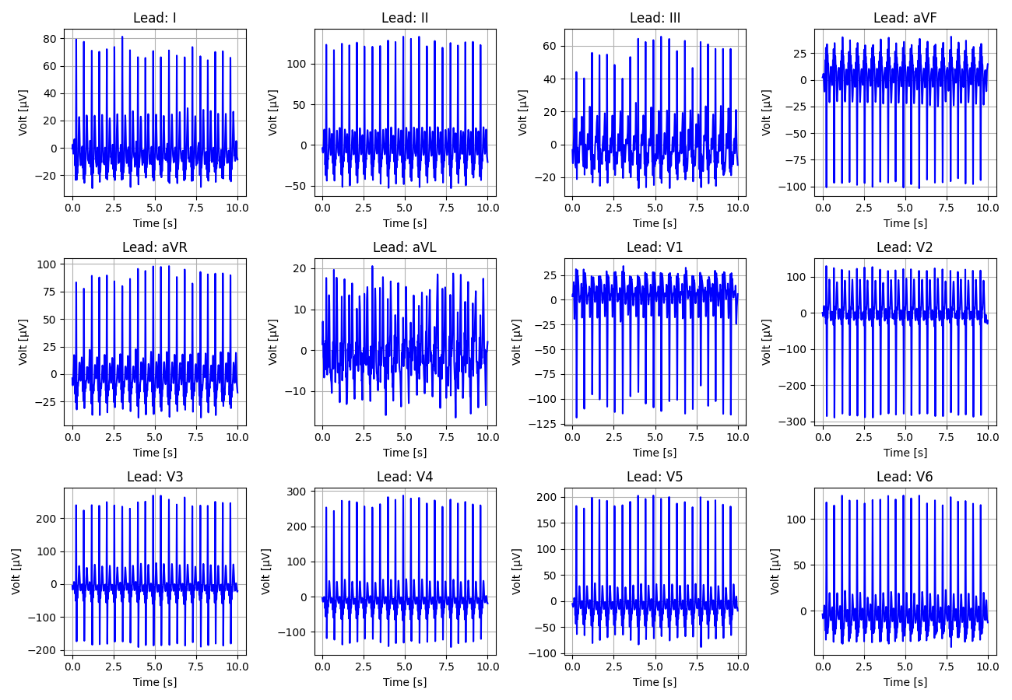
121_Recording_2791114

Slide 22
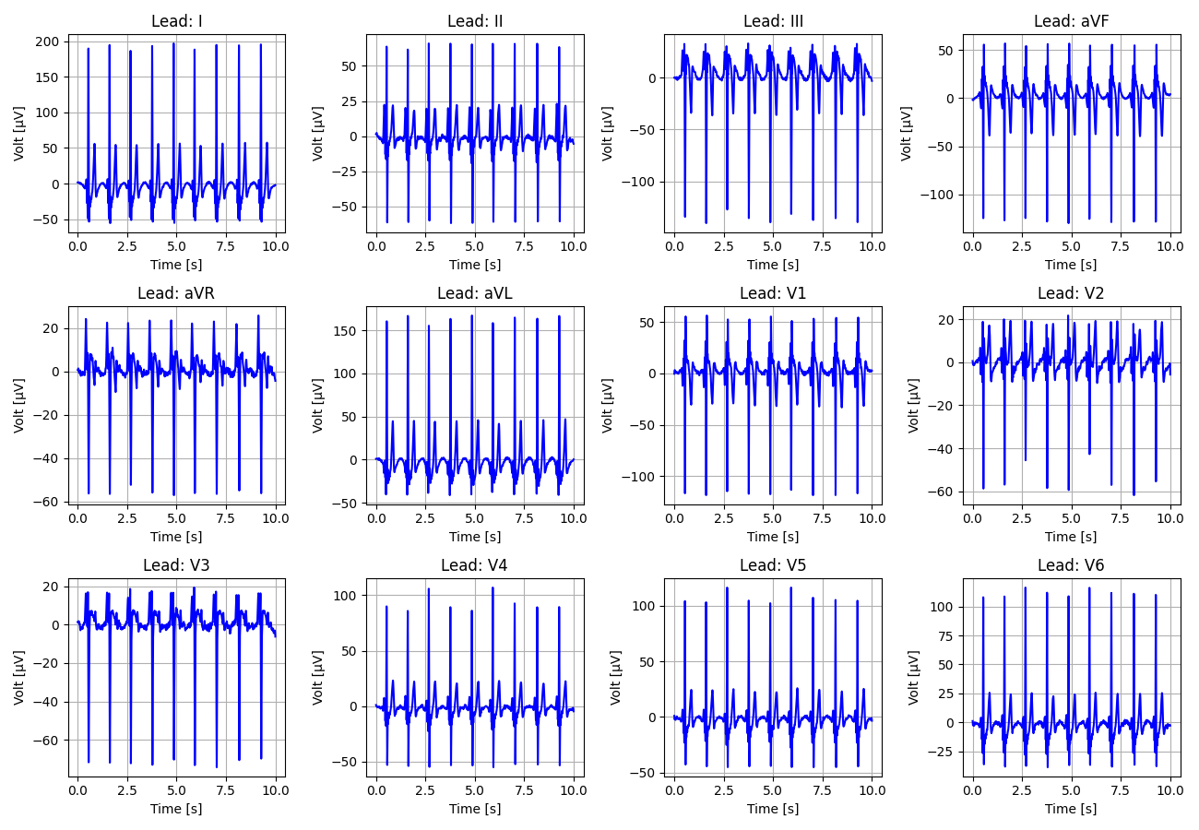
122_Recording_2395721

Slide 23
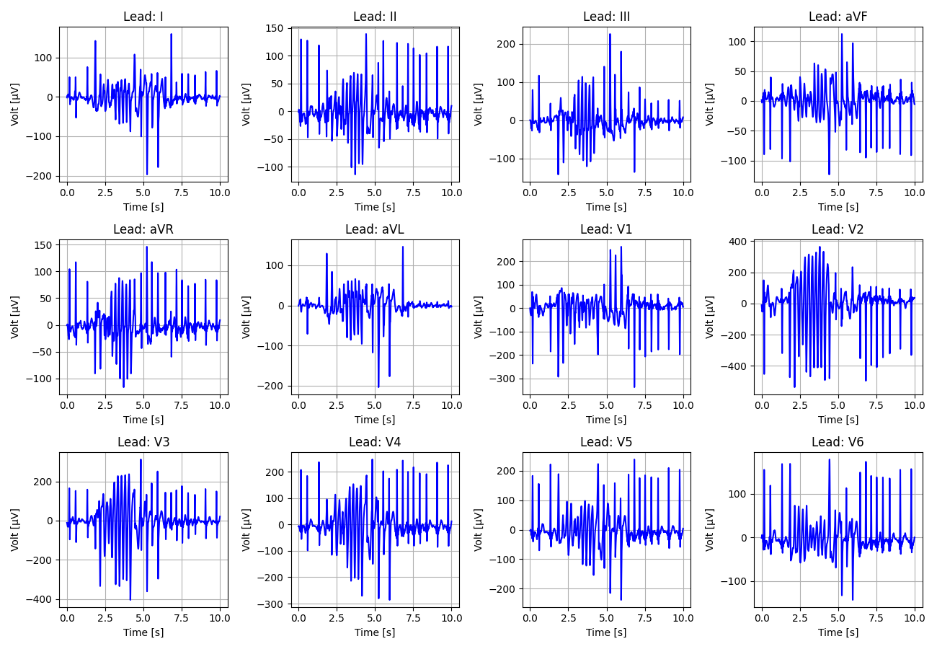
123_Recording_2812632

Slide 24
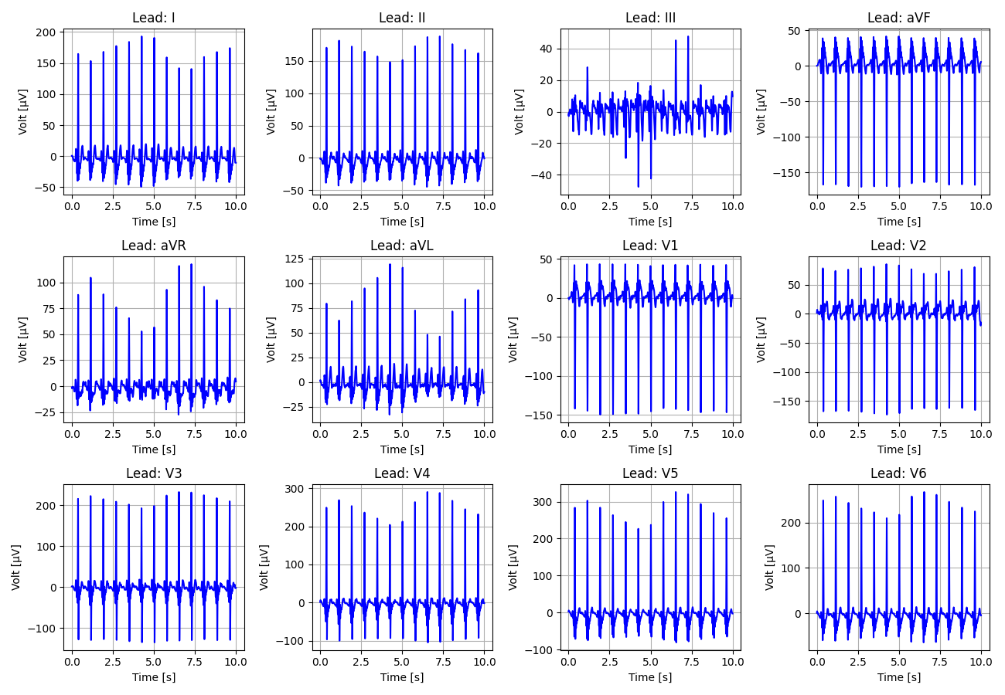
124_Recording_2553107

Slide 25
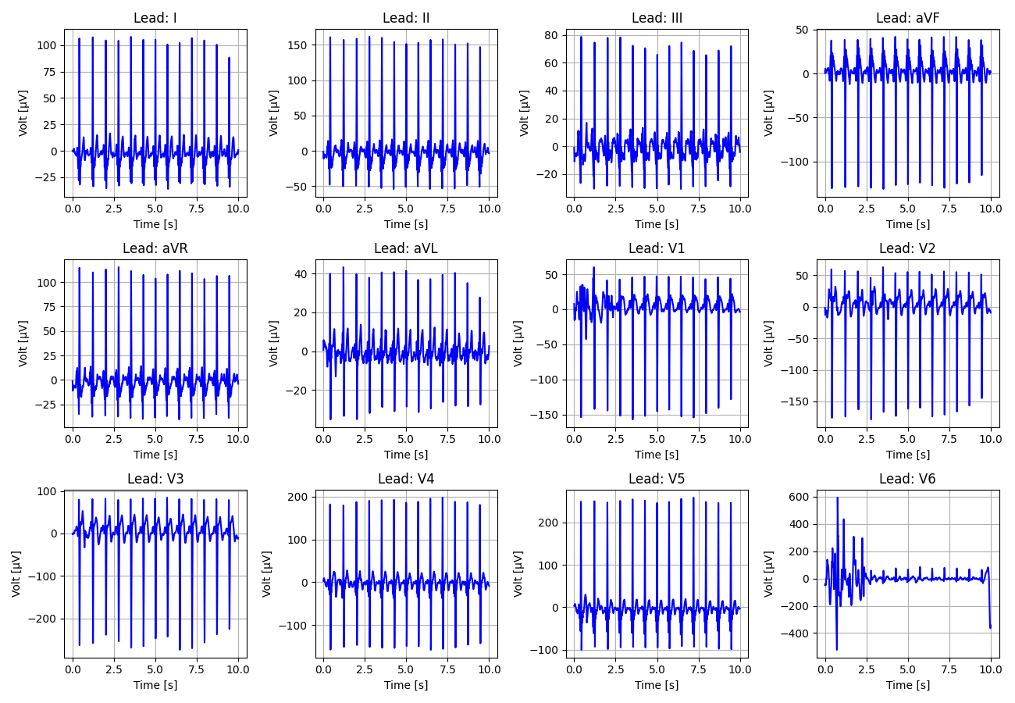
125_Recording_2689382

Slide 26
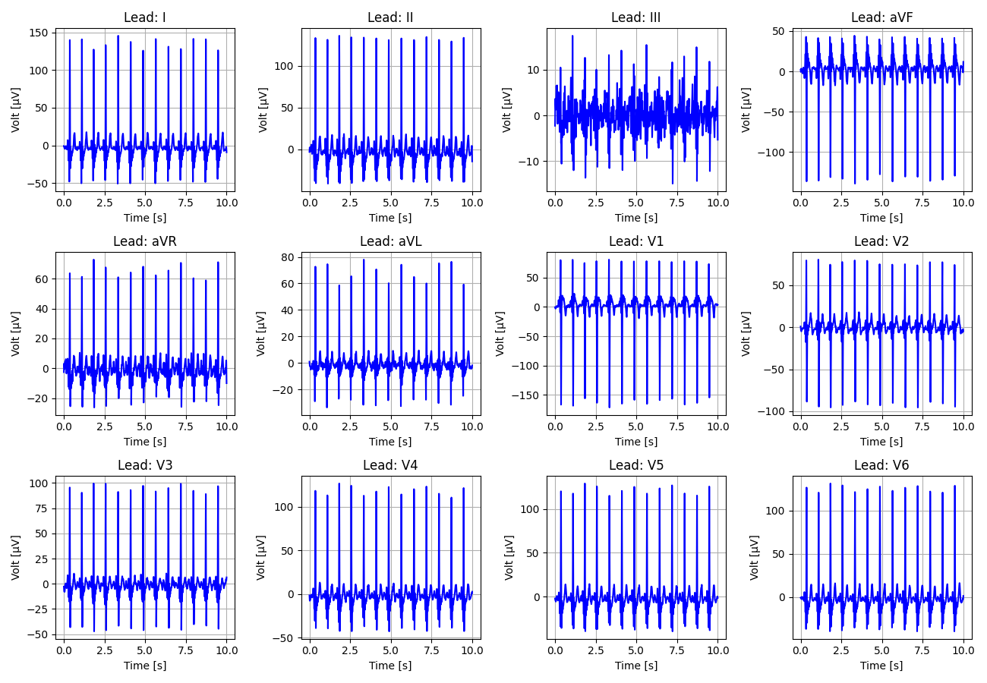
126_Recording_2216756

Slide 27
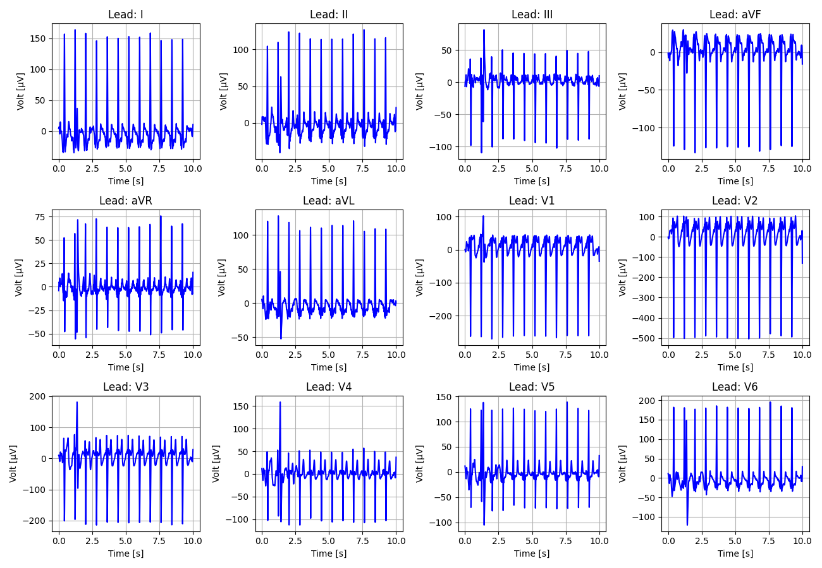
127_Recording_2621016

Slide 28
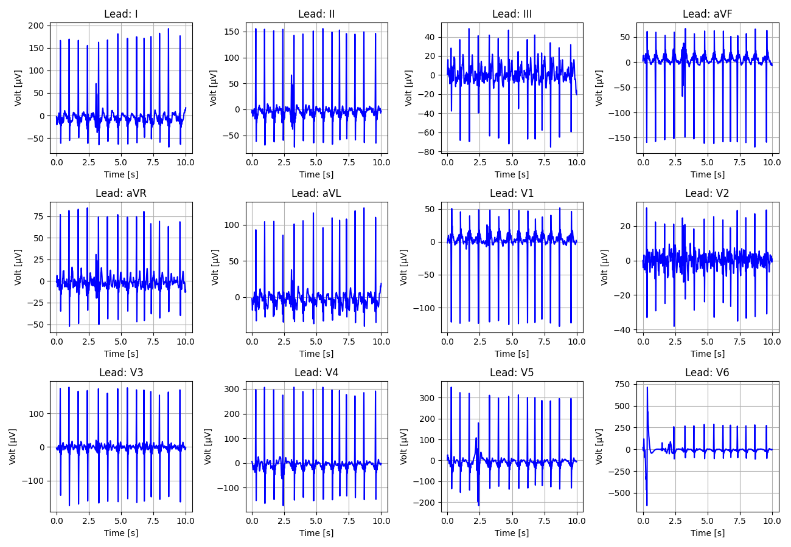
128_Recording_1228058

Slide 29
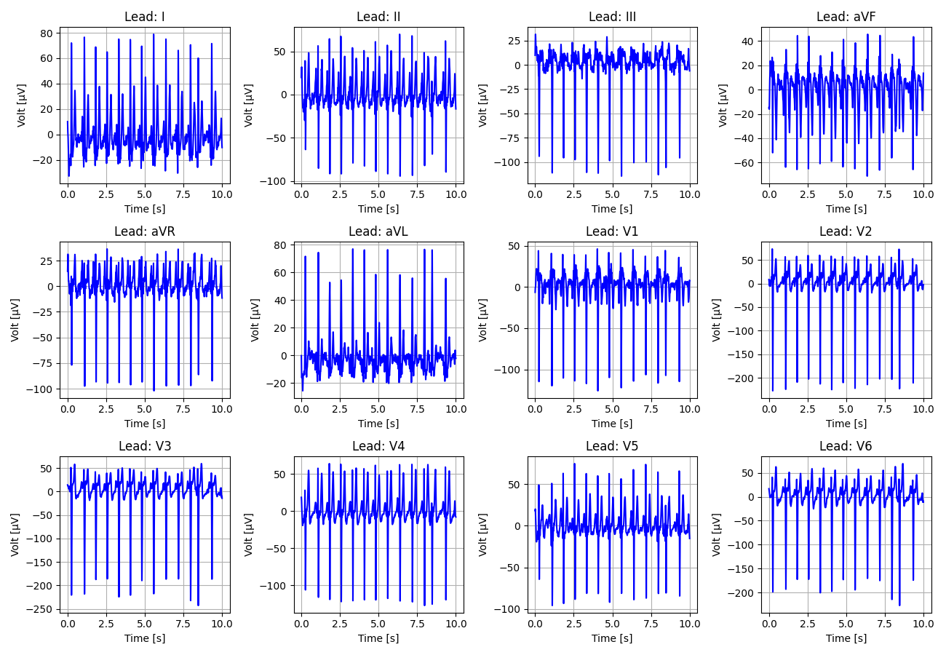
129_Recording_1616997

Slide 30
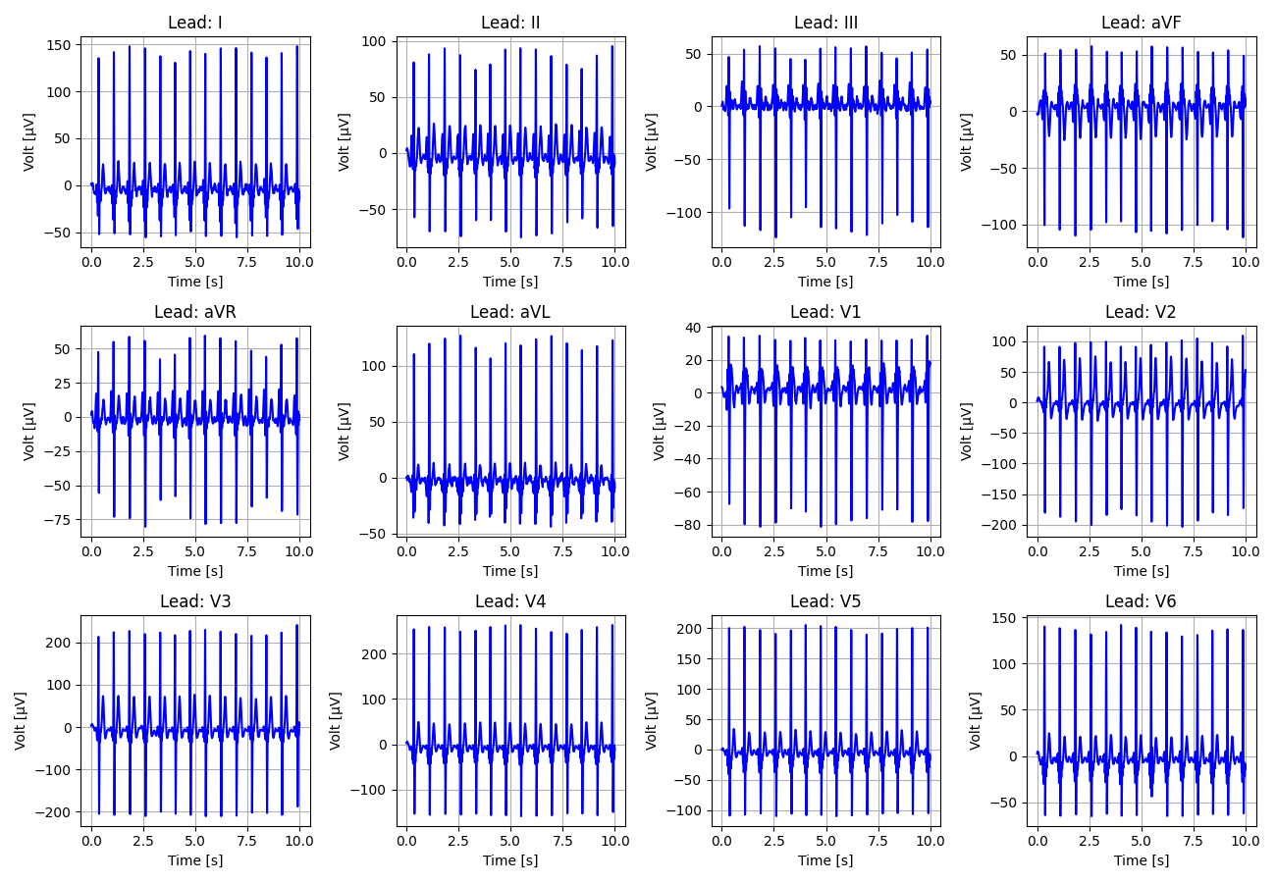
130_Recording_2181130

Slide 31
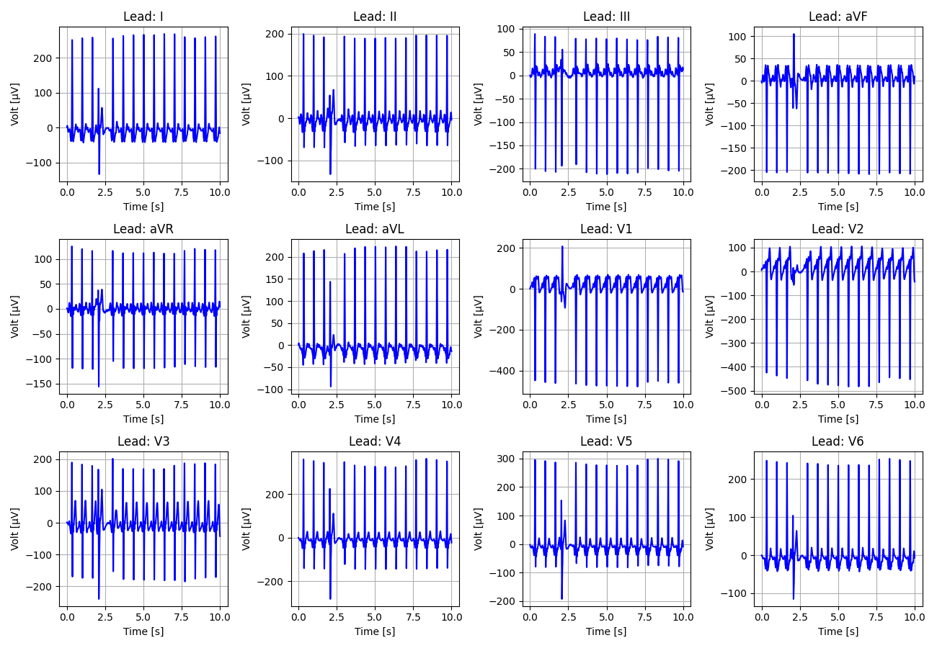
131_Recording_2893432

Slide 32
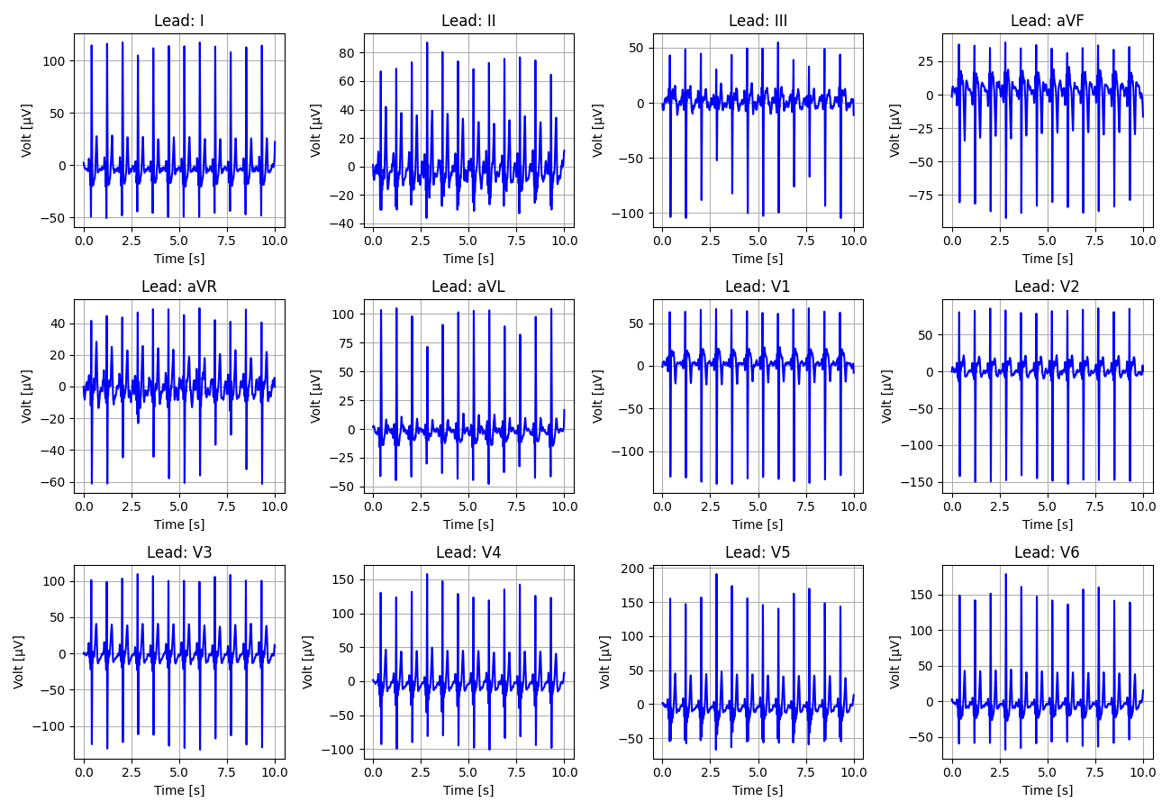
132_Recording_1429007

Slide 33
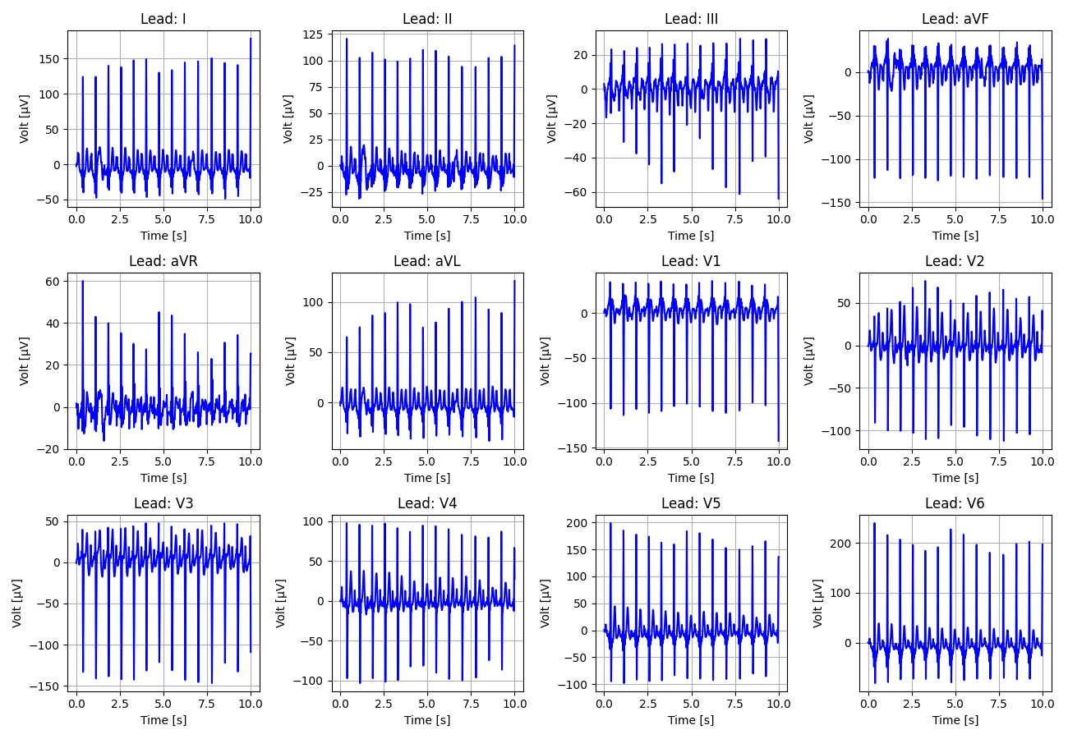
133_Recording_2352232

Slide 34
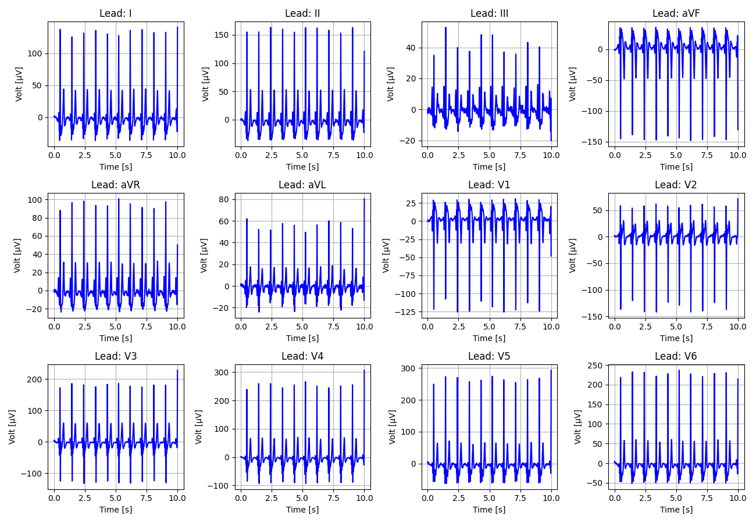
134_Recording_1715358

Slide 35
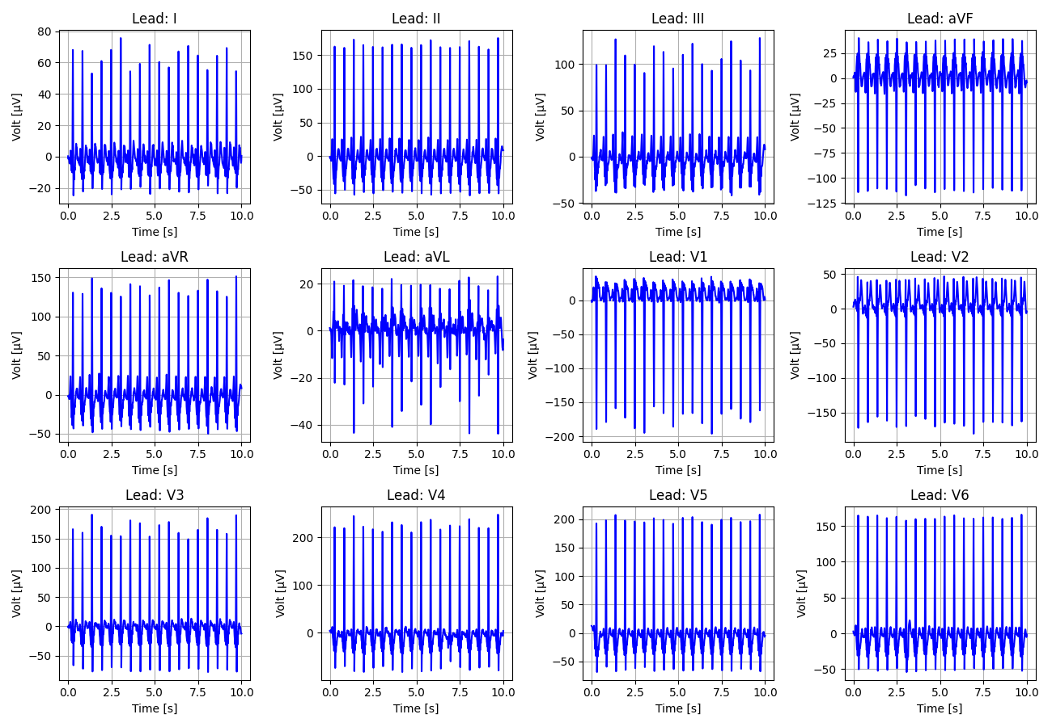
135_Recording_1423770

Slide 36
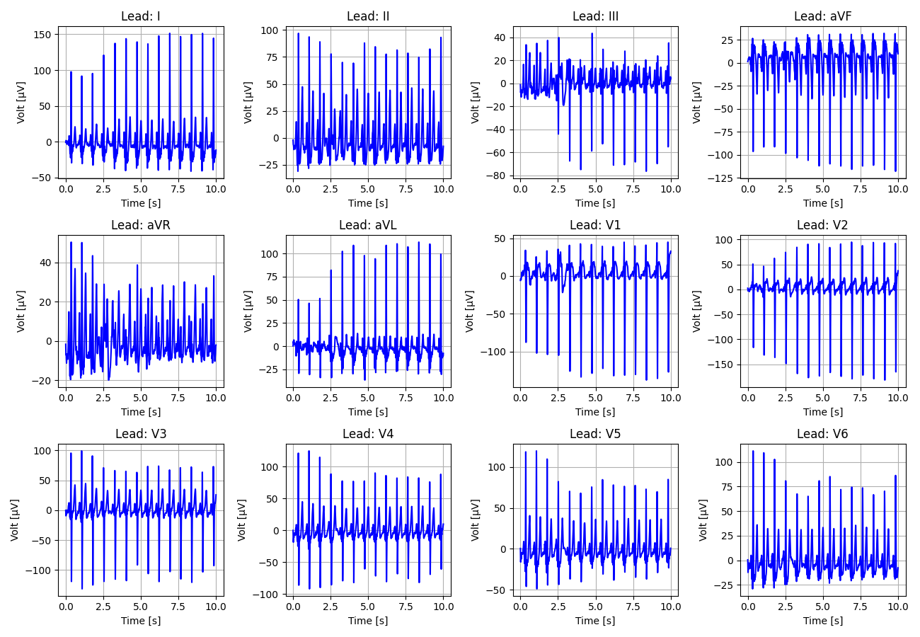
136_Recording_1568777

Slide 37
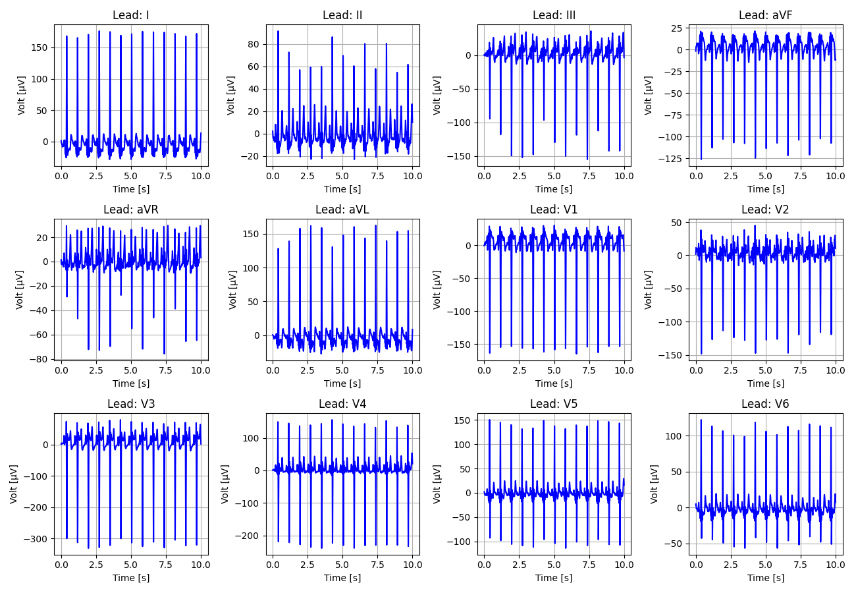
137_Recording_1902658

Slide 38
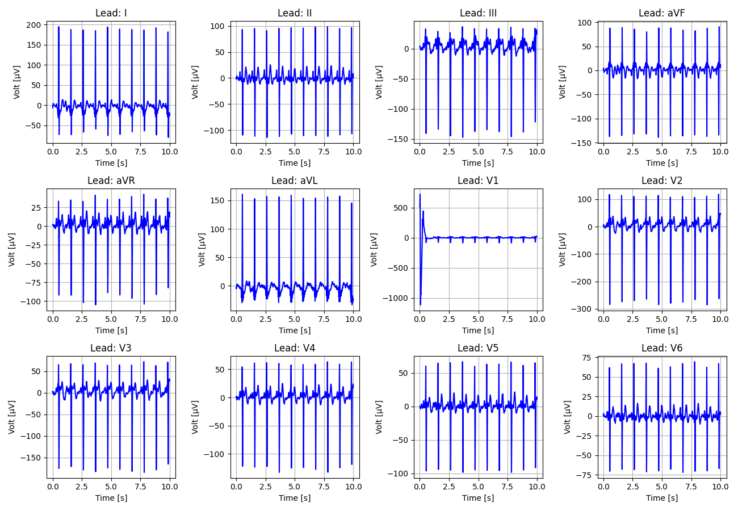
138_Recording_2427324

Slide 39
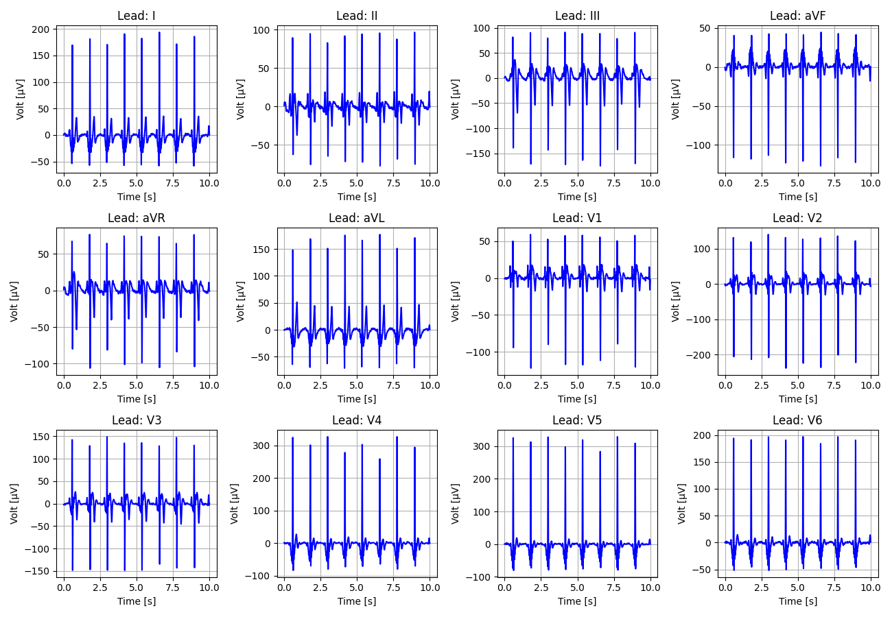
139_Recording_1702323

Slide 40
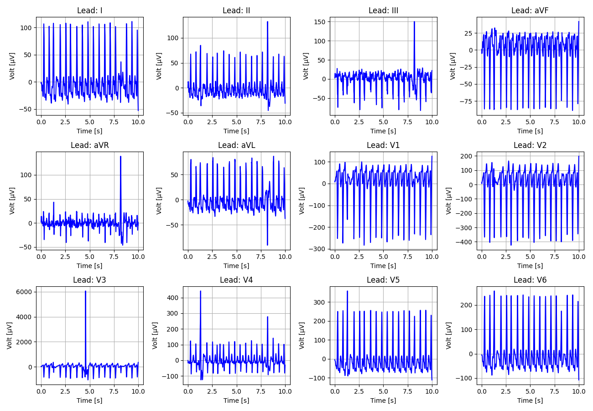
140_Recording_2516572

Slide 41
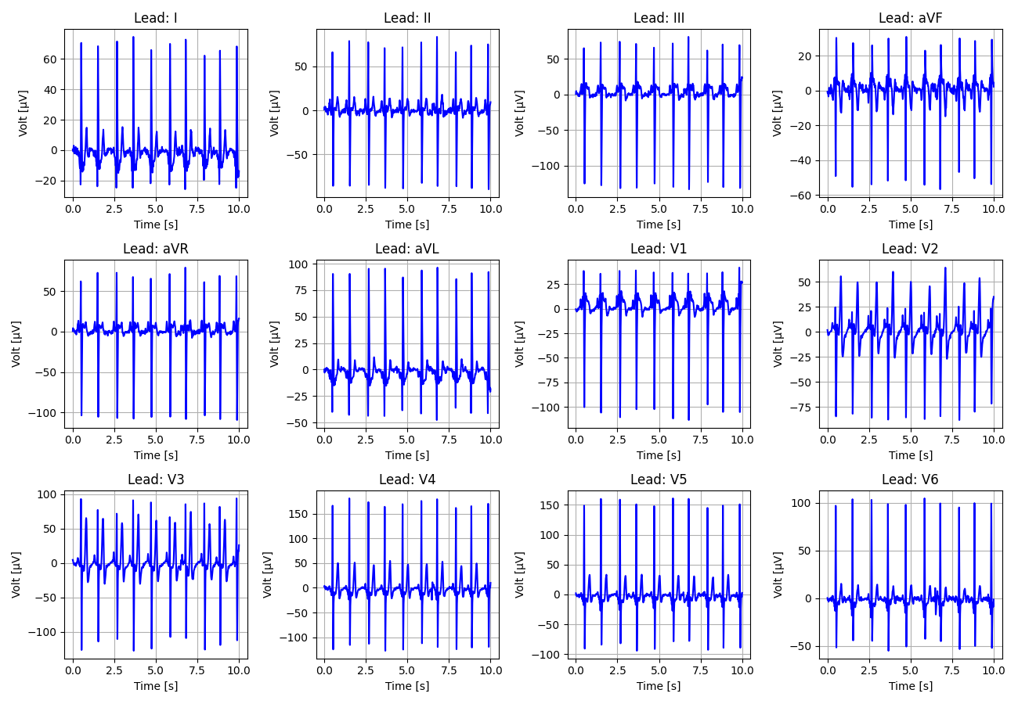
141_Recording_2265291

Slide 42
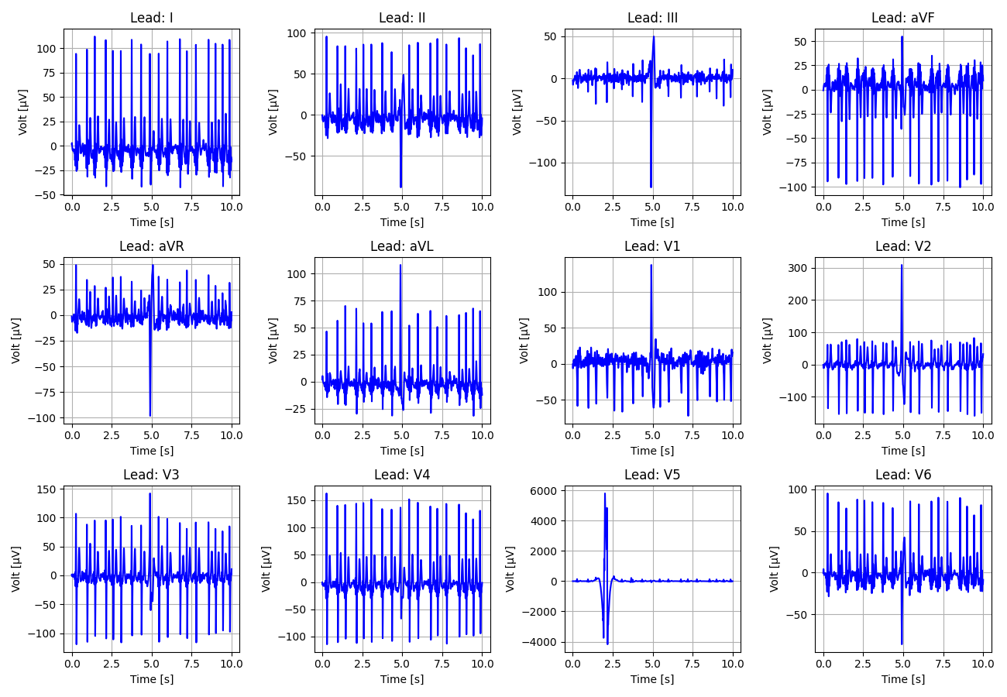
142_Recording_2597810

Slide 43
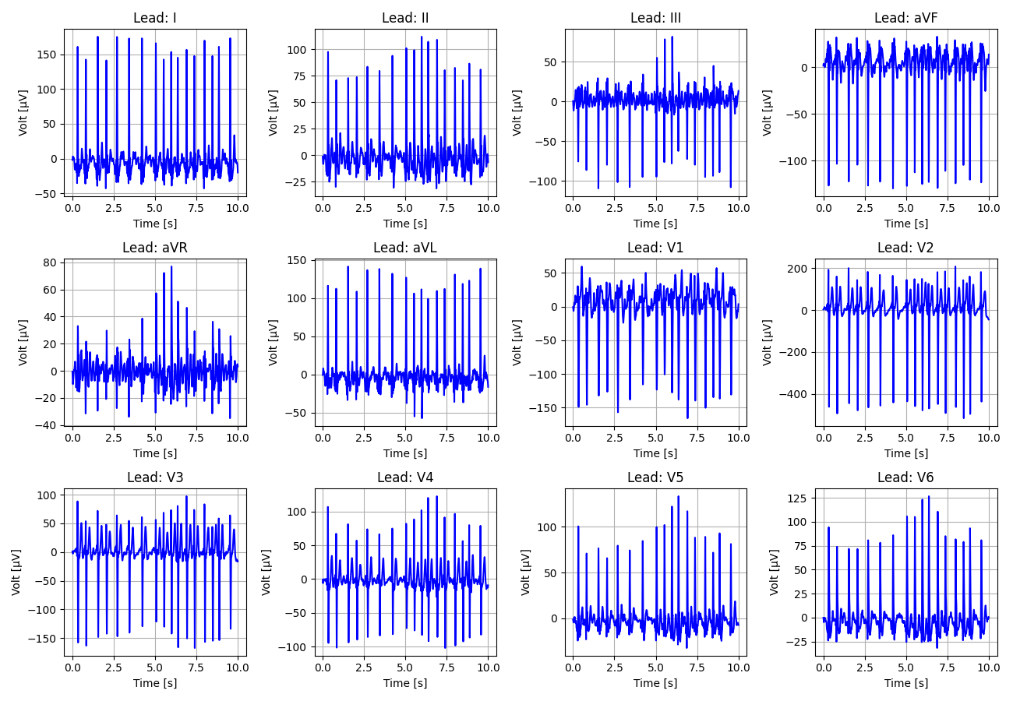
143_Recording_1703637

Slide 44
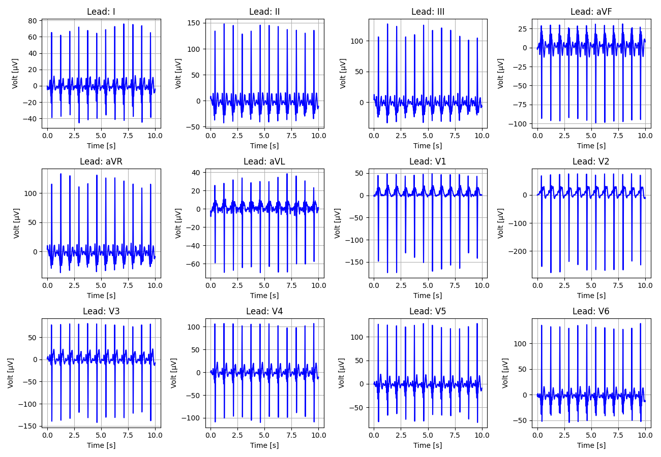
144_Recording_2221828

Slide 45
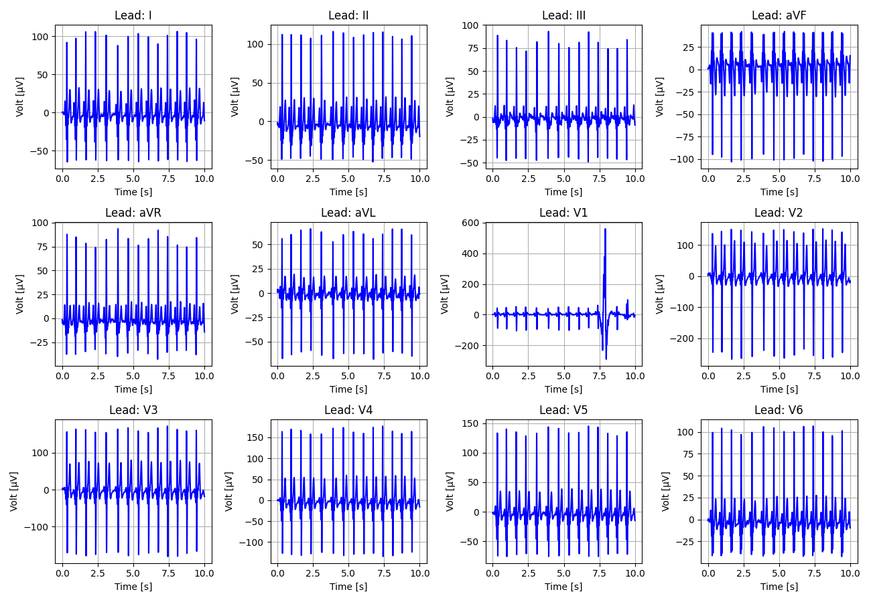
145_Recording_1580630

Slide 46
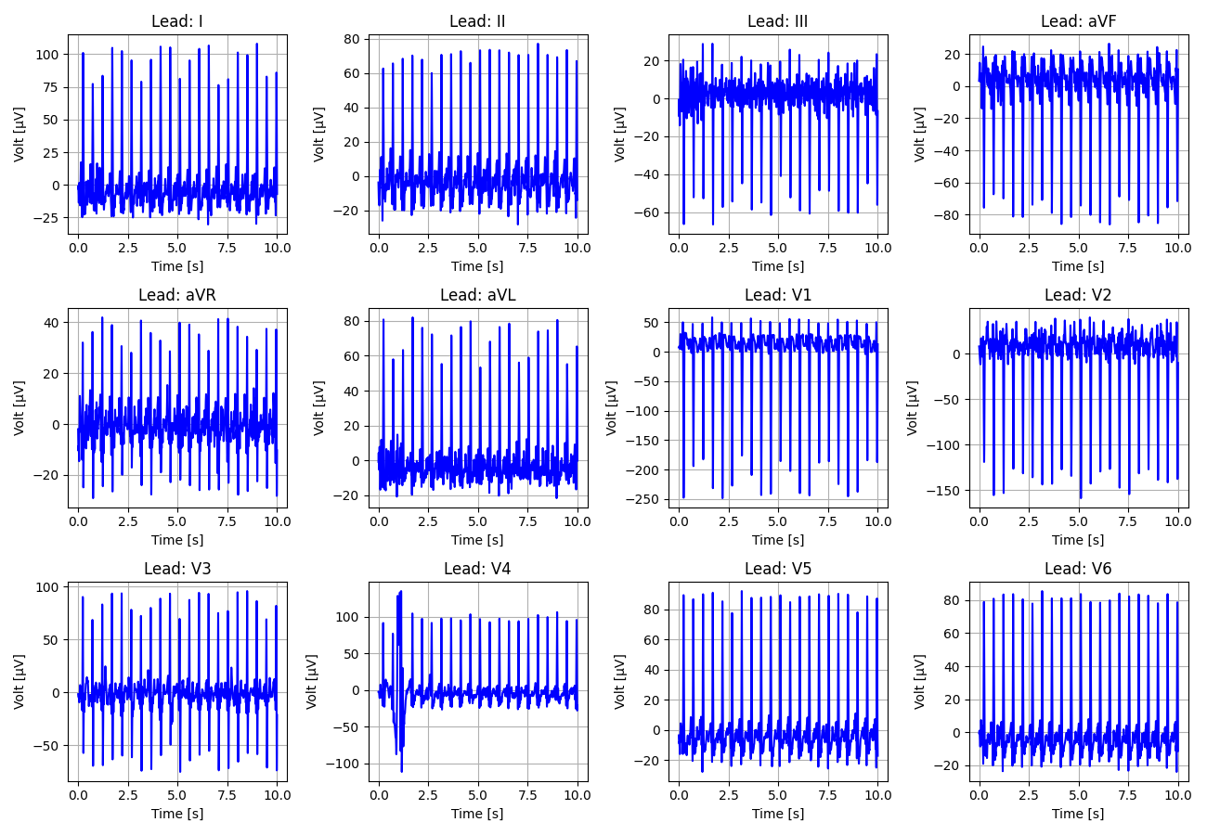
146_Recording_2550576

Slide 47
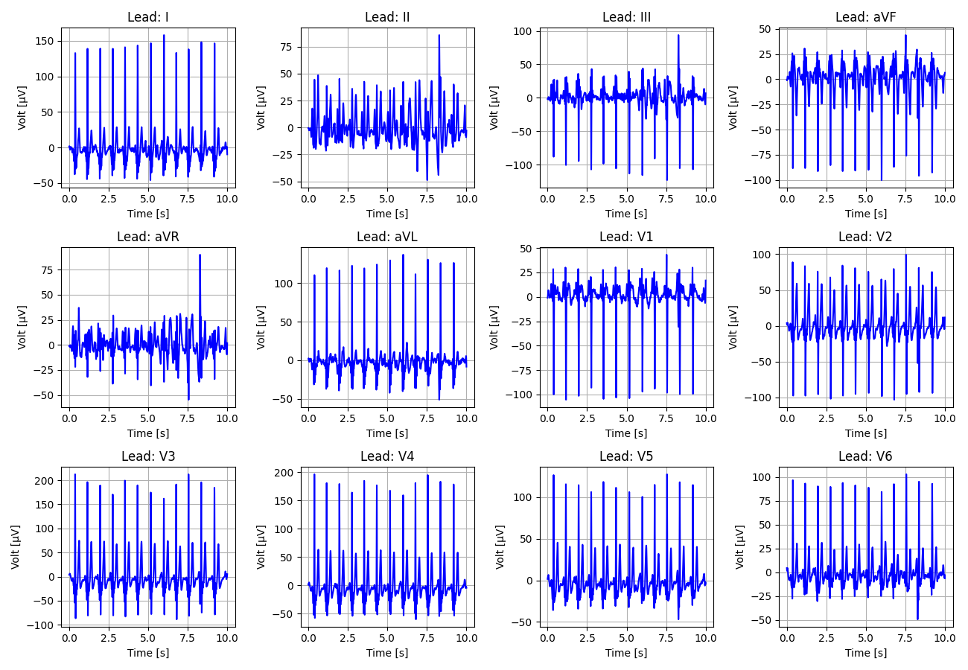
147_Recording_2131431

Slide 48
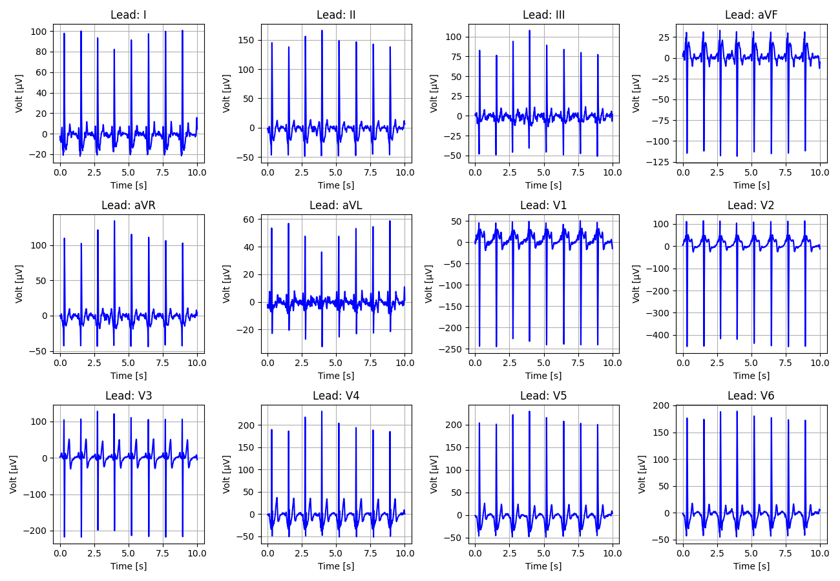
148_Recording_1240272

Slide 49
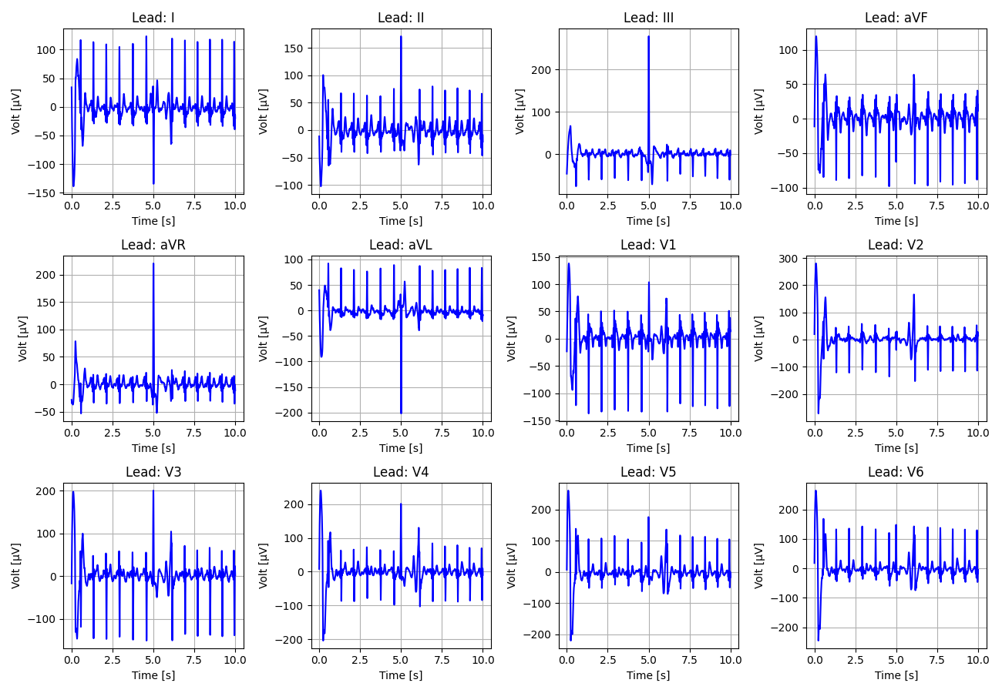
149_Recording_1995171

Slide 50
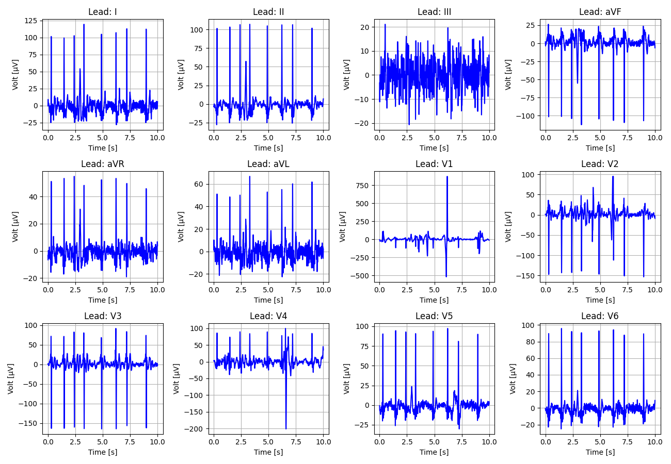
150_Recording_2424388

Slide 51

151_Recording_2225874

Slide 52

152_Recording_2846577

Slide 53

153_Recording_2376318

Slide 54

154_Recording_2969546

Slide 55

155_Recording_2508679

Slide 56

156_Recording_2123133

Slide 57

157_Recording_2878374

Slide 58

158_Recording_1166425

Slide 59

159_Recording_1035858

Slide 60

160_Recording_2382091

Slide 61

161_Recording_2243674

Slide 62

162_Recording_1516498

Slide 63

163_Recording_1238368

Slide 64

164_Recording_2888324

Slide 65

165_Recording_2554462

Slide 66

166_Recording_1620867

Slide 67

167_Recording_1708002

Slide 68

168_Recording_2421678

Slide 69

169_Recording_1370857

Slide 70

170_Recording_2772856

Slide 71

171_Recording_2919114

Slide 72

172_Recording_2080991

Slide 73

173_Recording_2406161

Slide 74

174_Recording_2167590

Slide 75

175_Recording_2445407

